Slide 1
French Songs

Slide 2

Numbers 1-20

Slide 3

Numbers 20-50

Slide 4

Numbers 50-70

Slide 5

Days of the week

Slide 6

Months of the year

Slide 7

Weather

Slide 8

Parts of the body

Slide 9
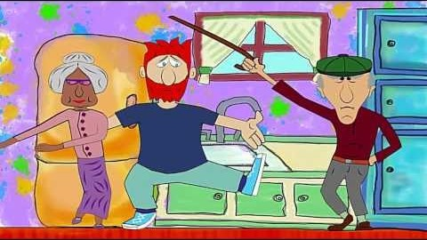
Family

