Slide 1
Today in writing, we are going to play a game!
It's called, "would you rather?"

Slide 2
Take out a piece of paper and pencil, or a word document on your computer

Slide 3
There will be several slides giving two scenarios. You pick which one "you would rather"
You are going to choose ONE slide to write about
This Photo by Unknown author is licensed under CC BY.

Slide 4
Once you have picked the slide you want to compare you are going to write about which "thing" you would rather do
When writing, you need to give 3 reason WHY you chose that item over the other item
AND
You need to give evidence for each reason

Slide 5
For example...
Question:
Would you rather go to Disneyland or Hawaii?
Answer
I would rather go to Disneyland because there are rollercoasters. For example you can go on Space Mountain or on The Matterhorn.
-rollercoasters is my reason, Space Mountain and The Matterhorn are my evidence
**Then you would give TWO more reasons with evidence

Slide 6
Time to play!
Remember, pick ONE slide to compare which "thing" you would rather do. Then give three reasons why you picked that item with evidence:)
If you want to do more than one, go ahead!

Slide 7
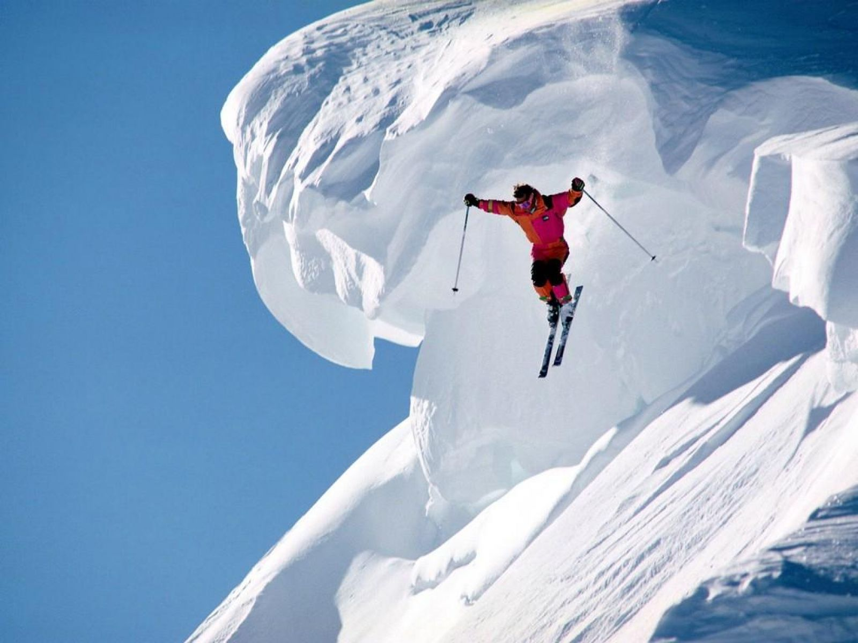
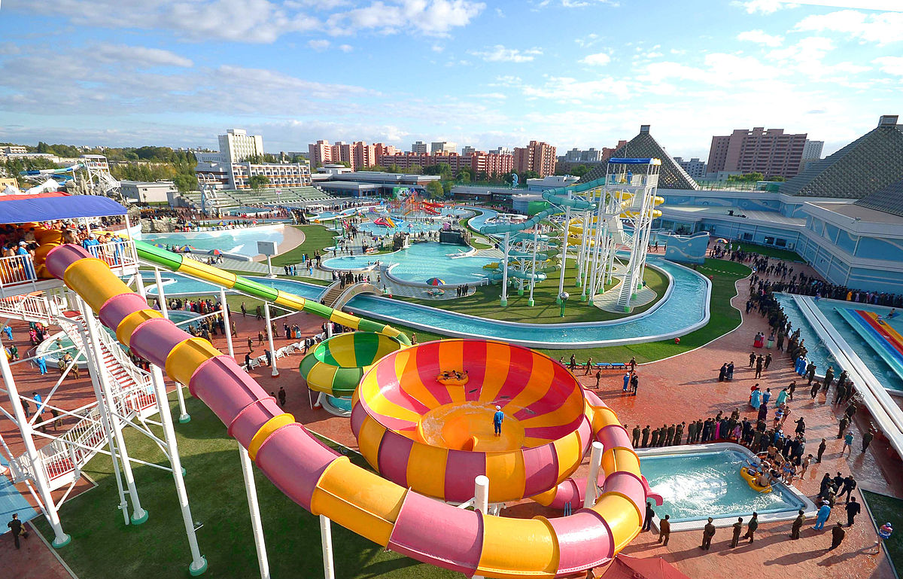
Would you rather…
Go skiing or go to a water park?

Slide 8
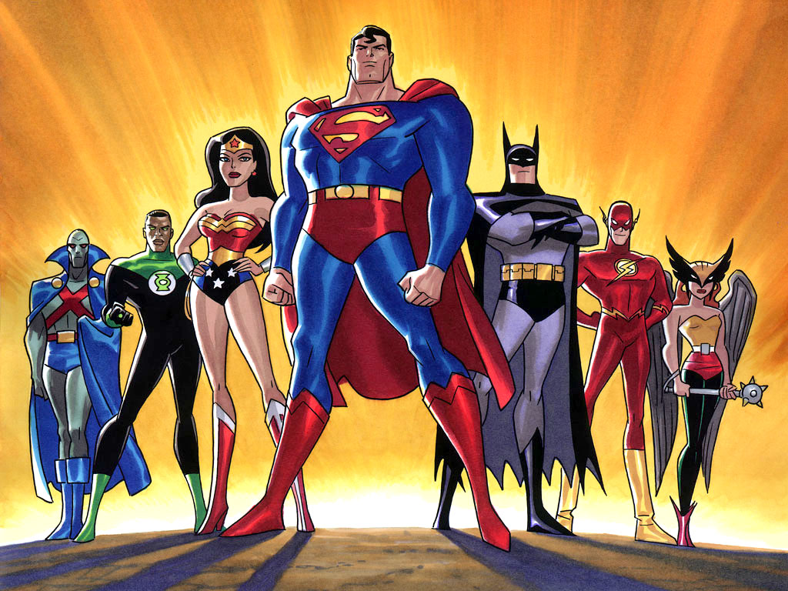
Would you rather…
Be a wizard or a superhero?

Slide 9
Would you rather…
Be able to create a new holiday or create a new sport?

Slide 10
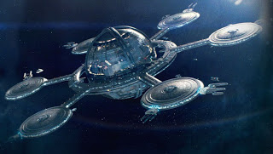
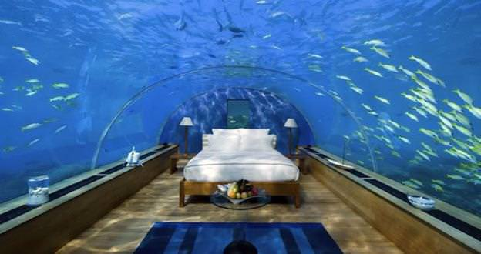
Would you rather…
Visit the international space station for week or stay in an underwater hotel for a week?

Slide 11
Would you rather
Be a detective or a pilot?

