Slide 1
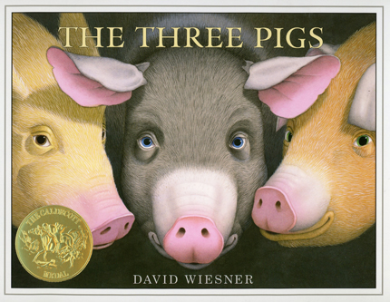
The Three Pigs by David Wiesner
VS.
The Three Little Pigs
(Cage match)
This Photo by Unknown author is licensed under CC BY-NC-ND.

Slide 2
And the winner is...?
The Three Pigs
Written in 2001
The Three Little Pigs
Written in 1890
Listen to The Three Pigs by David Wiesner
The Three Pigs
Notice the illustrations. There’s a lot going on in this picture storybook. As you listen, jot down what you think is unusual about this version.
Now compare it to the classic English fairy tale The Three Little Pigs.
Listen again: The Three Little Pigs Audio Only

Slide 3
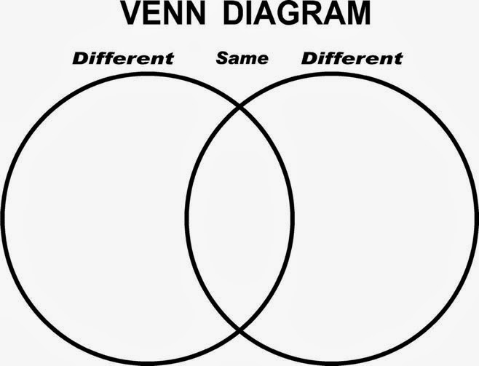
What do you notice?
Compare and contrast The Three Pigs with The Three Little Pigs using a Venn diagram.
Label one circle The Three Pigs and the other circle The Three Little Pigs. This is where you will write things that are different in the two stories.
The middle is for what is the same about the two stories, for example, they both have three pigs and a wolf.
This Photo by Unknown author is licensed under CC BY-SA-NC.
What is "furze"? Look it up. The 2nd pig built his house with furze.

Slide 4
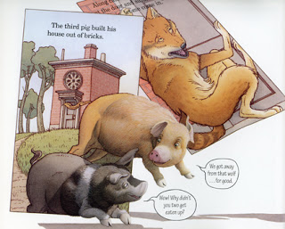
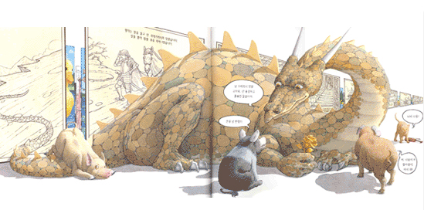
Writing
At the beginning of David Wiesner’s story, the first pig is blown right out of the story, and then he invites the second and third pigs to join him.
Copy the author’s idea and blow your pigs out of the story into a new kind of story. Where do they go? Create your own world that the pigs enter. What kinds of adventures do they have? Do new characters join them? What happens?
This Photo by Unknown author is licensed under CC BY-NC-ND.
This Photo by Unknown author is licensed under CC BY-NC-ND.

Slide 5
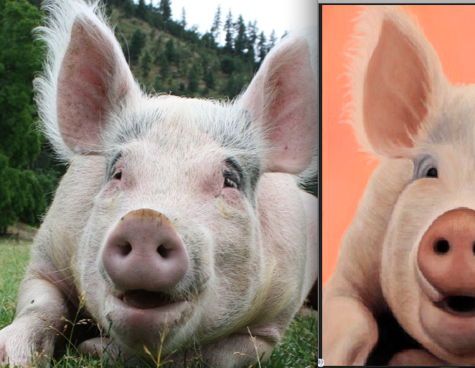
Be Creative!
What are you feeling, thinking, wondering, questioning, or imagining about The Three Pigs story?
Create a drama, a visual art piece, or video to show us (your teacher and maybe your class) your creative ideas around this story. Let your imagination run wild.
This Photo by Unknown author is licensed under CC BY-SA.
This Photo by Unknown author is licensed under CC BY-NC-ND.
This Photo by Unknown author is licensed under CC BY-SA-NC.

