Slide 1
Information writing lesson 1 of 3

Slide 2
Welcome writers!!
Today you are the teacher!

Slide 3
Did you know..
You can teach the teacher something!
You know more about Minecraft, nerf guns, meme's, sports, and many other things
Today, you will teach ME something :). You are going to write your very own information book

Slide 4
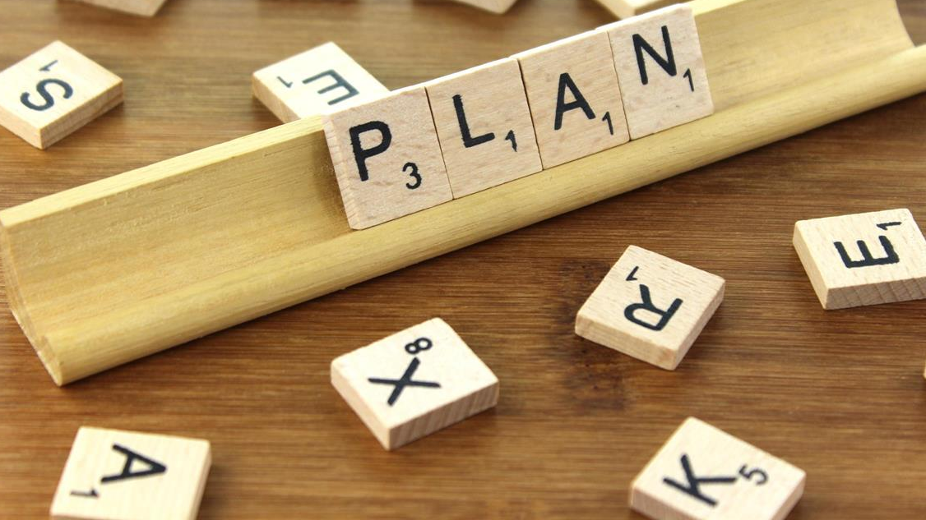
But FIRST..
You need a plan!
This Photo by Unknown author is licensed under CC BY-SA.

Slide 5
First..
Think about something you are an expert on. Something that you could teach the teacher. This is probably something you do often, something that you are good at, or somewhere you like to go.
I'll give my own example first!

Slide 6
My information book: Every July I go to watch the Fireworks! I'll teach you about Fireworks in my information book
BUT FIRST, here is my plan!
1) I imagine the fireworks in my head, like I'm replaying a movie
2) I plan what each page is going to teach my reader about fireworks.
3) Then I make a quick sketch on my paper of what fireworks look like
4) Then I write!

Slide 7
Here is my writing on fireworks. The first page is about different kinds of fireworks

Slide 8
My second page is about how fireworks can be dangerous

Slide 9
Now, it is your turn! Here are the steps for writing your own information book one more time :)
1) Think of something you could teach me. Something you are good at, do often, or somewhere you like to go
2) Imagine your idea in your head. Replay it like a movie
3) Take out some paper and plan what each page is going to teach your reader
4) Then I make a quick sketch on each page showing what you will write about
5) Then write!

