Slide 1
Decimal Menu Task

Slide 2
Your Task
Take a look at the menu on the following slide and answer the questions on the slide after it.
If you want to do a challenge, see slide five.

Slide 3
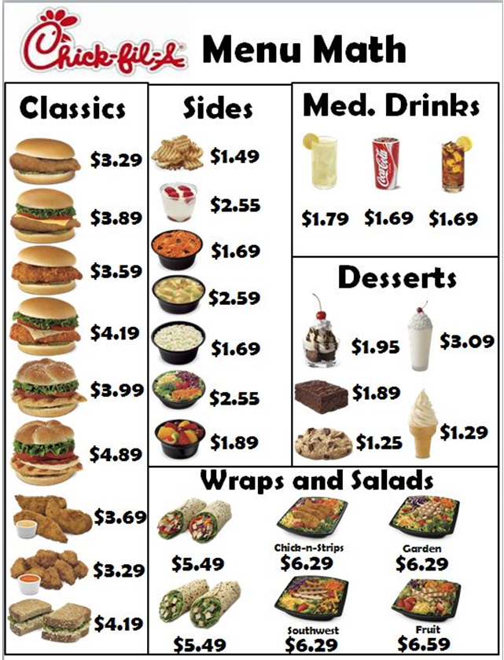

Slide 4
Questions
What item on the menu costs the most?
What item on the menu costs the least?
How much more is the most expensive item than the least expensive?
Choose 5 items of the menu and order them from least to greatest. Explain how you did it.
You are ordering food for your family for supper. What will you order? Write down all the items and the prices.
What was the most expensive item?
How much did you spend altogether?
Write 2 questions that you could ask and answer from the menu. Answer them.

Slide 5
Challenge!
Find the website of a local restaurant.
Browse the menu.
Answer the questions from the previous slide.
Make up an order for you family. (Do not actually place the order unless you have permission ☺)

