Slide 1
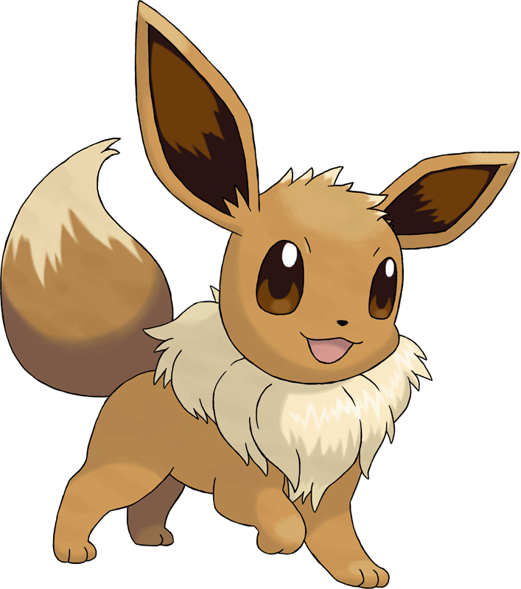
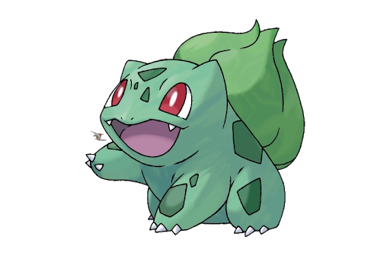
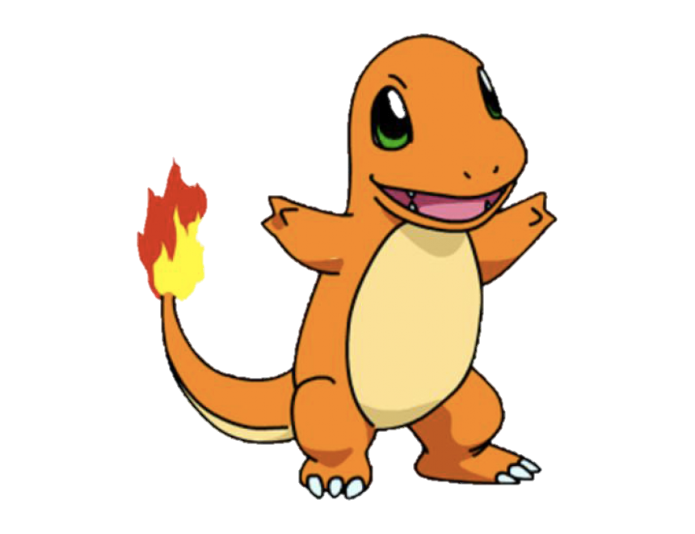
Sight Words!
Sound!
Picture!
Too!
Much!

Slide 2
Over

Slide 3
New

Slide 4
Sound

Slide 5
Take

Slide 6
Only

Slide 7
Little

Slide 8
Work

Slide 9
Know

Slide 10
Place

Slide 11
Get up and do 5 jumping jacks!

Slide 12
Years

Slide 13
Live

Slide 14
Me

Slide 15
Back

Slide 16
Give

Slide 17
Most

Slide 18
Very

Slide 19
After

Slide 20
Thing

Slide 21
Our

Slide 22
Dance Break!

Slide 23
Just

Slide 24
Name

Slide 25
Good

Slide 26
Sentence

Slide 27
Man

Slide 28
Think

Slide 29
Say

Slide 30
Great

Slide 31
Where

Slide 32
Help

Slide 33
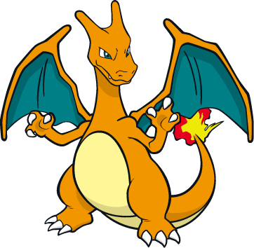
Mirror mirror! Make your partner follow your actions for 30 seconds

Slide 34
Through

Slide 35
Much

Slide 36
Before

Slide 37
Line

Slide 38
Right

Slide 39
Too

Slide 40
Means

Slide 41
Old

Slide 42
Any

Slide 43
Same

Slide 44
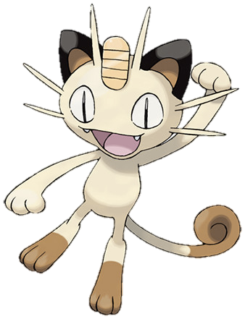
Pretend to jump rope!

Slide 45
Tell

Slide 46
Boy

Slide 47
Following

Slide 48
Came

Slide 49
Want

Slide 50
Show

Slide 51
Also

Slide 52
Around

Slide 53
Farm

Slide 54
Three

Slide 55
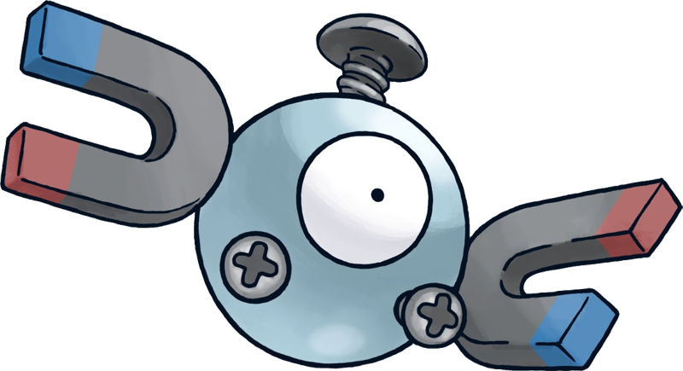
Get your wiggles out!

Slide 56
Small

Slide 57
Set

Slide 58
Put

Slide 59
End

Slide 60
Does

Slide 61
Another

Slide 62
Well

Slide 63
Large

Slide 64
Must

Slide 65
Big

Slide 66
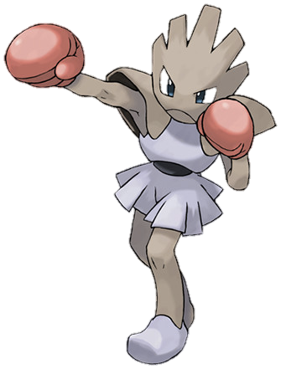
Do 5 push ups!

Slide 67
Even

Slide 68
Such

Slide 69
Because

Slide 70
Turn

Slide 71
Here

Slide 72
Why

Slide 73
Asked

Slide 74
Went

Slide 75
Men

Slide 76
Read

Slide 77
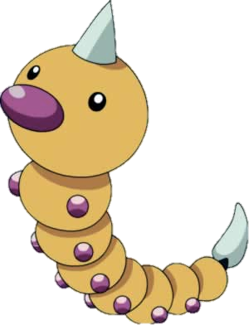
Spin around 5 times!

Slide 78
Need

Slide 79
Land

Slide 80
Different

Slide 81
Home

Slide 82
Us

Slide 83
Move

Slide 84
Try

Slide 85
Kind

Slide 86
Hand

Slide 87
Picture

Slide 88
Rock, Paper, Scissors with your partner

Slide 89
Again

Slide 90
Change

Slide 91
Off

Slide 92
Play

Slide 93
Spell

Slide 94
Air

Slide 95
Away

Slide 96
Animals

Slide 97
House

Slide 98
Point

Slide 99
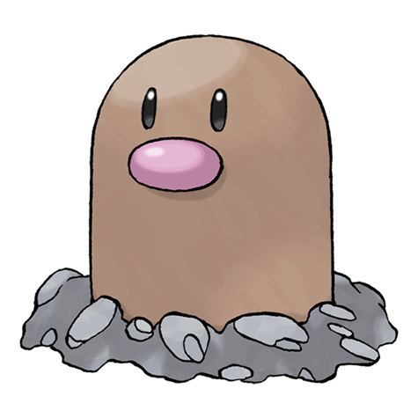
Your choice!

Slide 100
Page

Slide 101
Letters

Slide 102
Mother

Slide 103
Answer

Slide 104
Found

Slide 105
Study

Slide 106
Still

Slide 107
Learn

Slide 108
Should

Slide 109
America

Slide 110
World

