Slide 1
Information writing lesson 2 of 3

Slide 2
Writers ask who, what, where, when, and why questions in their information books
This Photo by Unknown author is licensed under CC BY-SA-NC.

Slide 3
Welcome writers!
You did so great being the teacher yesterday with your writing! You wrote your very own information book
Now it is time to go back and see if we can add even more details to our first draft
We are going to do this by asking our self:
-Who, what, where, and why questions

Slide 4
Let's start by looking at my writing about fireworks yesterday. I think I can add more to this page

Slide 5
I can ask myself these questions about "why fireworks are dangerous" to help make my writing longer
Who can or can't do fireworks?
What injuries can fireworks cause?
Where should and shouldn't fireworks be lit?

Slide 6
Now, it's your turn
Go to your writing from yesterday and find a page that you could add more to. Ask yourself who, what, where, when, and why questions to help make your writing longer

Slide 7
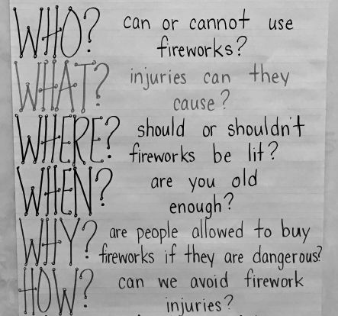
Here are the questions I asked myself.

