Slide 1

Under the Sea!

Slide 2
What do I do?
(First, this is an activity that you might want to do over two weeks, or you might want to count it as both a reading and writing activity. You decide.)
1. Listen to the sing-a-long book on Slide 4.
2. Complete the activities related to the book.
3. Research 2 of the sea creatures featured in the book.
4. Research 2 more sea creatures.
5. Send all of your work back to your teacher.

Slide 3
How do I send my work back to my teacher?
You have a couple of different options…
1. You could download the Power Point on your computer, complete it right on the screen, and send it back to your teacher.
2. If you have a printer you could print the pages off, complete them in pencil, take a picture of them, and email them back to your teacher.

Slide 4
Read Along!
Listen to the sing-a-long book Over in the Ocean.
https://www.youtube.com/watch?v=CD4LBluWv2Q&t=54s

Slide 5
“Over in the Ocean”
List the verbs which describe the ACTION of the sea creatures
Present Tense | Past Tense
1.
2.
3.
4.
5.
6.
7.
8.
9.
10.
Present Tense | Past Tense
1.
2.
3.
4.
5.
6.
7.
8.
9.
10.

Slide 6
List the rhyming words in each verse
Verse 1: ___________________and ________________
Verse 2: __________________ and ________________
Verse 3:___________________ and ________________
Verse 4: __________________and ________________
Verse 5: __________________ and ________________
Verse 6: __________________and ________________
Verse 7: ___________________and ________________
Verse 8: __________________and ________________
Verse 9: __________________and ________________
Verse 10: _________________and ________________
Verse 11: ______ and _____ ______ and_______

Slide 7
Describe where each sea creature lived.
The octopus lived in the __________________.
The parrotfish lived in the __________________________.
The clownfish lived in the __________ _______________.
The stingray lived in the _________ __________ __________.
The pufferfish lived where the ________ __________ ________.
The angelfish lived in their __________ __________ _________.
The sea horse lived in their ____________ __________ _______.

Slide 8
The author described the needlefish as being very ______________________ and _________________.
Bonus Question….(you may have to do a bit of research on the seahorse to answer this question)
Why, in verse 10, did the author say “father”, instead of “mother”? ________________________________
_________________________________________

Slide 9
Research 2 Sea Creatures from the book
In the first box, illustrate your sea creature.
Think of one or two adjectives to describe your sea creature. (Remember that adjectives are describing words.
Think of one or two verbs to describe how your sea creature moves. (Remember that verbs are action words.)
Write a simili about your sea creature. Remember, a simili is a comparison between two things using either the word “like” or “as”. For example “The sea bed was as colourful as a rainbow” or ”The shark’s teeth cut like a knife.”
Write at least 3 interesting facts about your sea creature. The facts might relate to its shape, its size, a unique ability it possesses, or how it protects itself.

Slide 10
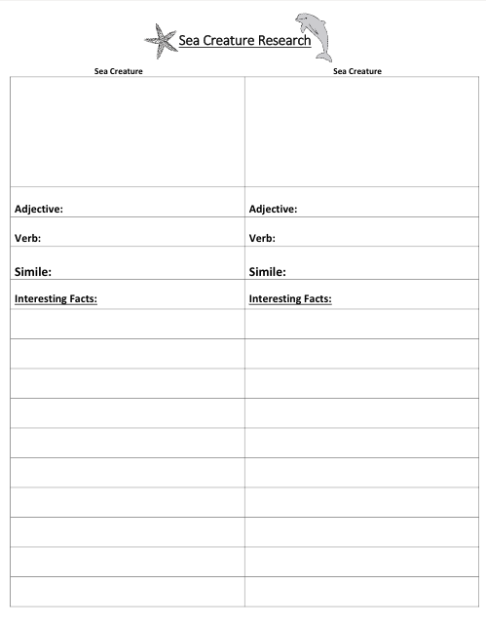
Now, choose two more sea creatures to research. They might be ones in the book, or other ones that you are interested in knowing more about.

Slide 11
Meet the illustrator!
Jeannette Canyon created the beautiful illustrations in Over in the Ocean by using Polymer Clay and then photographing her masterpieces. Learn more about this talented artist by visiting her web site:
http://www.jeanetteandchristophercanyon.com/OfficialWebsite/About_Jeanette_Canyon.html
To learn more about how to make polymer clay canes, watch this video:
https://www.youtube.com/watch?v=28SbYmRAufY&t=44s

