Slide 1
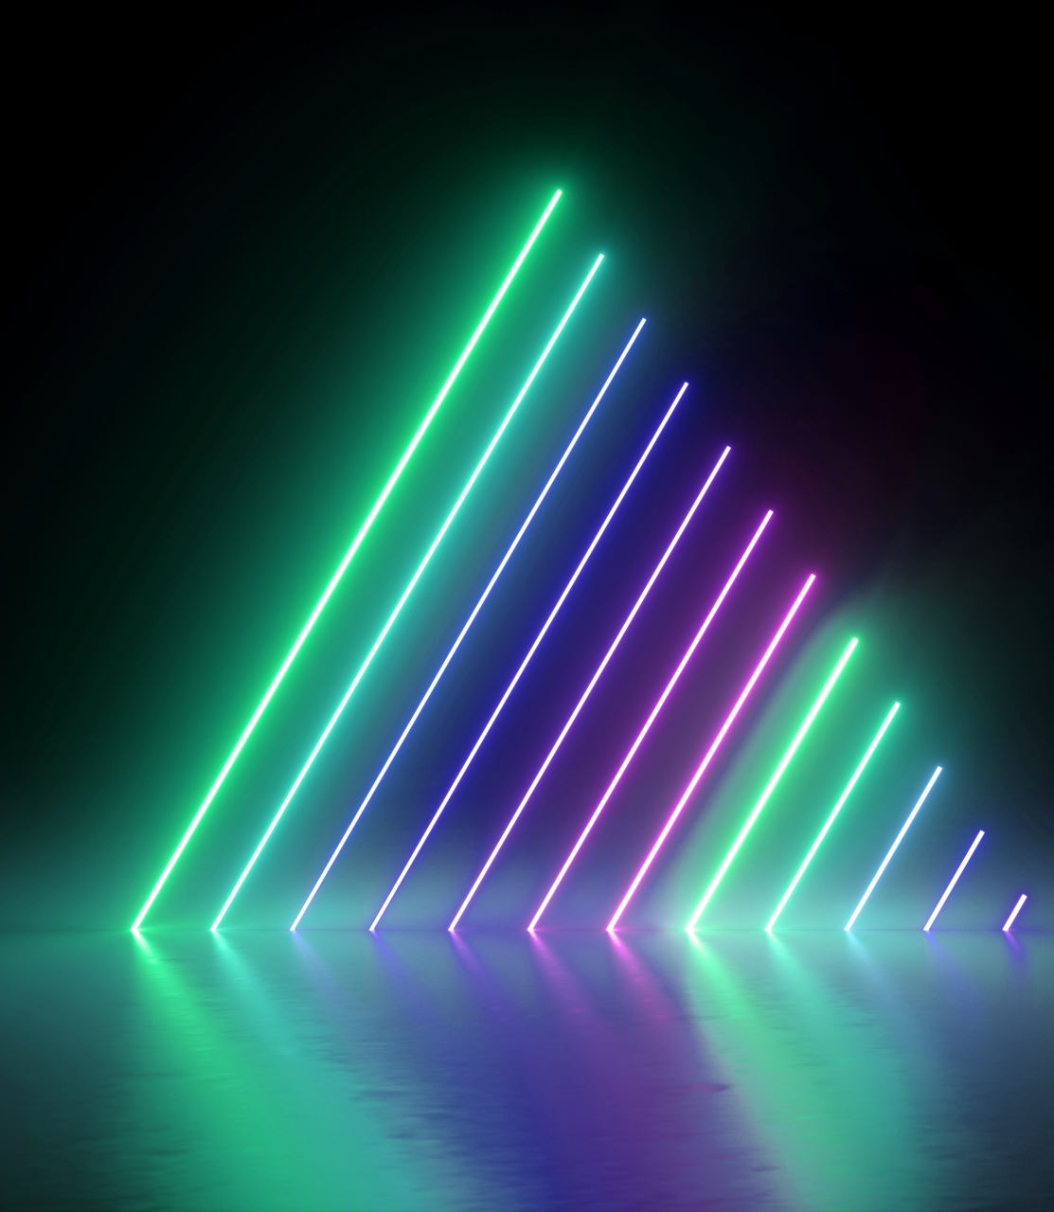
Bill Nye- Light and Colour

Slide 2
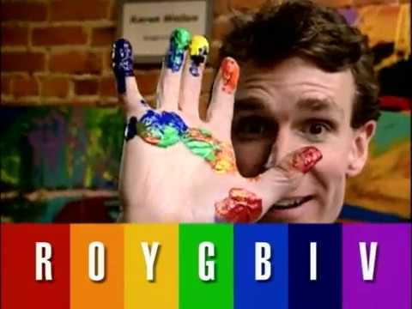
Watch the video and fill out the worksheet :) Click Here Bill Nye Light and Colour

