Slide 1
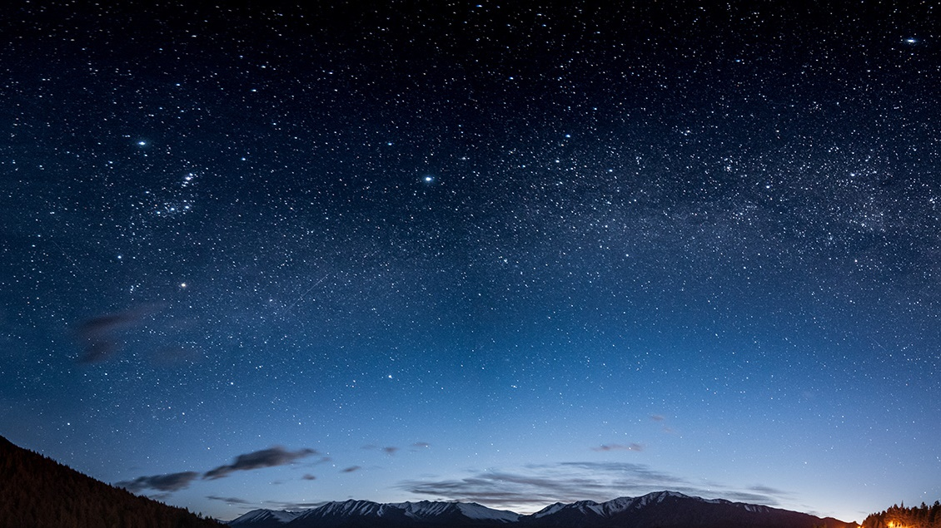
Area and Perimeter
Lesson 2 of 3
Yellow Team – Online Learning

Slide 2
Just a reminder of how to solve Area and Perimeter:
When solving PERIMETER, add up all the sides of the shape.
When solving AREA, count all the square units inside, or multiply the length by the width of the rectangle/square.

Slide 3
Taking what we practiced last time, try these: You have been given the area, but what was multiplied to get there?
Answers:
10
3
5
8
__ km.
9 km.
4 km.
__ km.
Area = 32 sq. Kilometers.
Area = 45 sq. Kilometers.
__km.
7 km.
What could the sides of a rectangle be can be made with an area of 12? (Answer, any of these would work: 12x1, 6x2, 4x3, 3x4, 2x6, 1x12)
2 km.
__km.
Area = 20 sq. Kilometers.
Area = 21 sq. Kilometers.

Slide 4
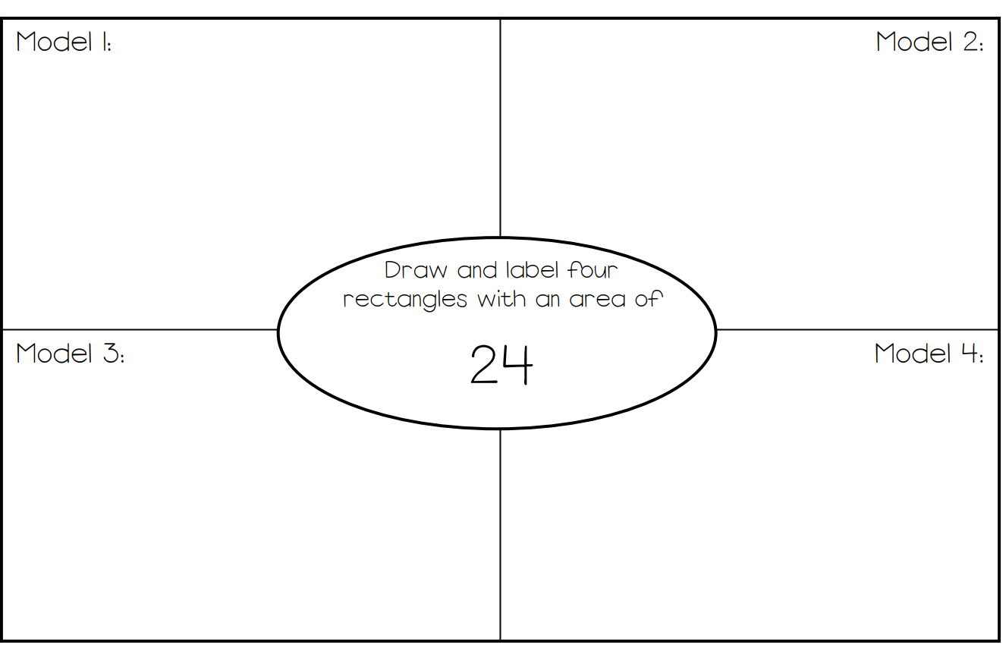
What would the sides of the rectangle be if it had an area of...
(Hint: You have the answer to the multiplication, but how could you get there?)
Example: What could the sides of a rectangle be with an area of 12? (Answer, any of these would work: 12x1, 6x2, 4x3, 3x4, 2x6, 1x12...) Challenge yourself, don’t use the One Times Table!
**Remember the Drawing tool.

Slide 5
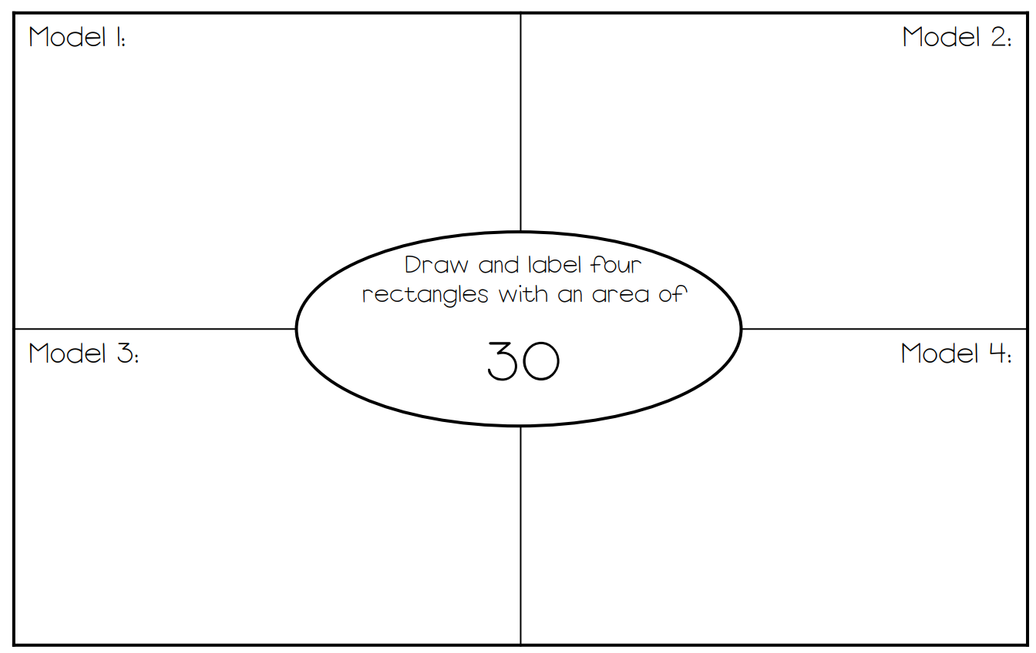
Final Area Practice

Slide 6
Perimeter Practice
Example:
Yes, they should all be different...very funny! You know who you are.

Slide 7
You are going to design a Mall!
1. Use the templates on the next couple of slides to create a mall.
2. Each store in your mall will be a different shape of rectangle.
3. You will have to label your store (EB games, Chapters, Galaxy Cinema, NY Fries etc....whatever you want) and figure out the area and perimeter of each store!

Slide 9
