Slide 1
Area and Perimeter
Lesson 3 of 3
Yellow Team Online Learning

Slide 2
This is the Final lesson, it will be the most challenging, but there are games at the end!!
Just a reminder: To figure out perimeter, add up all the sides. To figure out area, multiply the length by the width of the rectangle or count the square units inside.

Slide 3
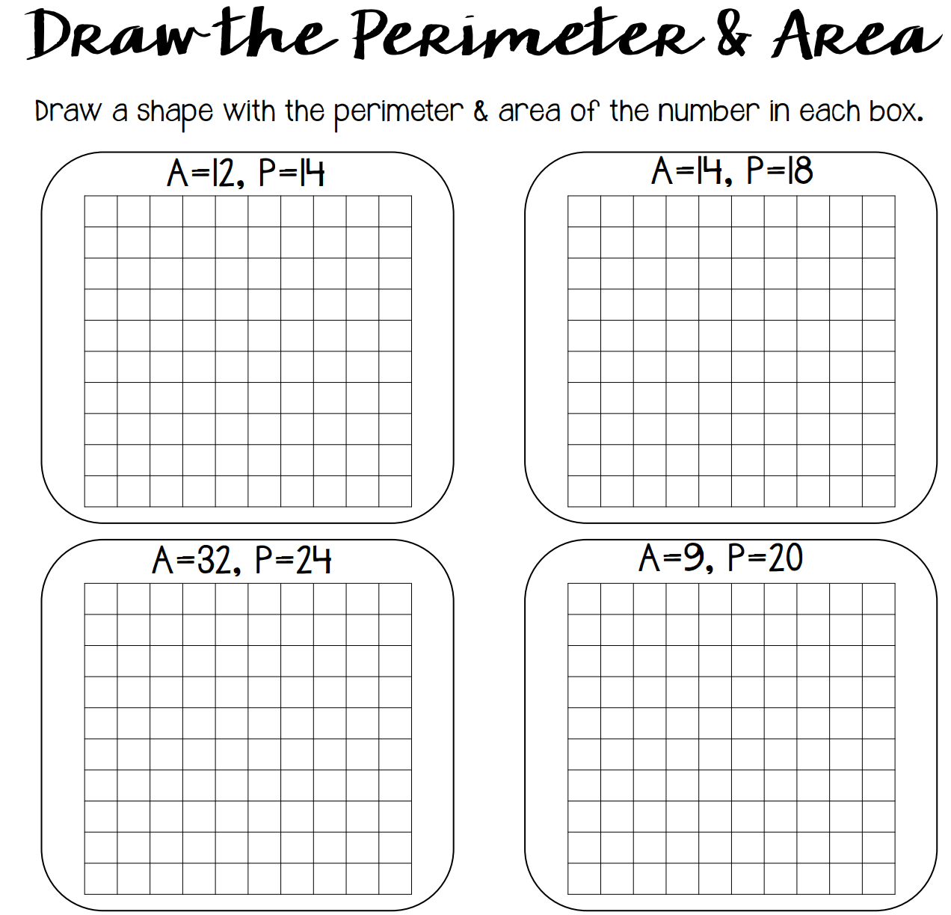
You must find a rectangle that will equal the given area AND perimeter. SO if you find the area, but it doesn’t equal the perimeter, and vice versa, then obviously it is wrong.
For Example: What is multiplied (length x Width) that equals 12 while all four sides add to 14?

Slide 4
Of Course we have to do some word problems:
Answers should match one of these:
30
99
7
34
Your classroom has an area of 72 sqaure meters. It is eight meters wide. What is the perimeter of your classroom?
.
A napkin has an area of 56 centimeters. It is 8 centimeters long. What is the width of the napkin?
.
Riley wanted to paint a pink strip around her bedroom. If her bedroom is 11 meters long and 9 meters wide, what is the area of her bedroom?
.
Bella's picture frame has a perimeter of 100 centimeters. The frame is 20 centimeters wide. How long is the picture frame?
.

Slide 5
Thank You!
Please check out this website for some area practice games:
Check out this website to keep your skills sharp with Area. It will ask you to verify your age, but everything is free!
Area:
https://www.education.com/games/area/
Perimeter:
https://toytheater.com/perimeter-climber/
Area and Perimeter: https://www.roomrecess.com/mobile/GeoTombs/play.html

