Slide 1
Division
Yellow Team
Lesson 1 of 3

Slide 2
Division: Some of the symbols used for division include: or / or )

Slide 3
We are going to start with the basics (hopefully)!
How many groups of TWO can you make?
An easy way to do this is to circle the groups of 2:

Slide 4
Hopefully your answers looked something like this:
I can make 4 groups of 2
I can make 6 groups of 2
I can make 8 groups of 2

Slide 5
Let's take it one step further:
How many alien heads are there in total? …....8
How many groups did you make?........4
How many in each group?....2
How many apples are there in total? …....12
How many groups did you make?........6
How many in each group?....2
How many apples are there in total? …....16
How many groups did you make?........8
How many in each group?....2
8 4 = 2
12 6 = 2
16 8 = 2
This Photo by Unknown author is licensed under CC BY-SA.

Slide 6
Let's Keep Practicing:
** Remember to circle the groups you are trying to make
How many groups of 5 can you make?
How many groups of 3 can you make?
How many groups of 7 can you make?
Total Hats?
How many groups?
How many in each group?
Total Bones?
How many groups?
How many in each group?
Total Band-aides?
How many groups?
How many in each group?

Slide 7
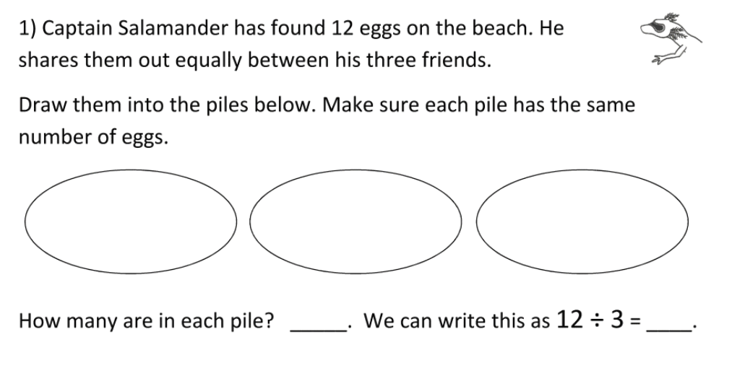
Division can be looked at as putting items into EQUAL groups:
How many in each group
Total Number of Eggs
Number of Groups

Slide 9
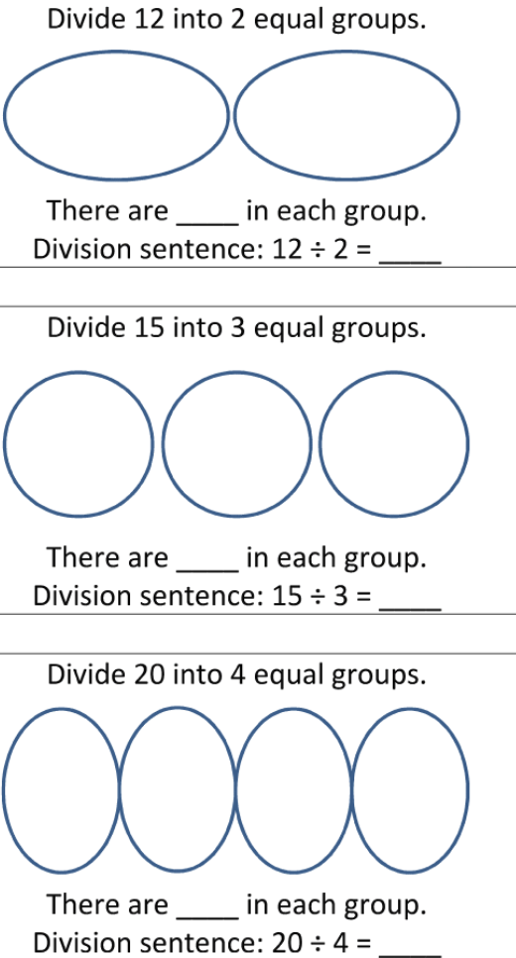
Practice:

Slide 10
Now let's try to get the Division question, based on the picture:
Example:
Step 1: Count the total..ants = 9
Step 2: Count the groups = 3
Step 3: Count how many are in each group. =3
So 9 3 = 3 ------- The Division Question

