Slide 1
Using Multiplication to Divide
Lesson 2 of 3

Slide 2
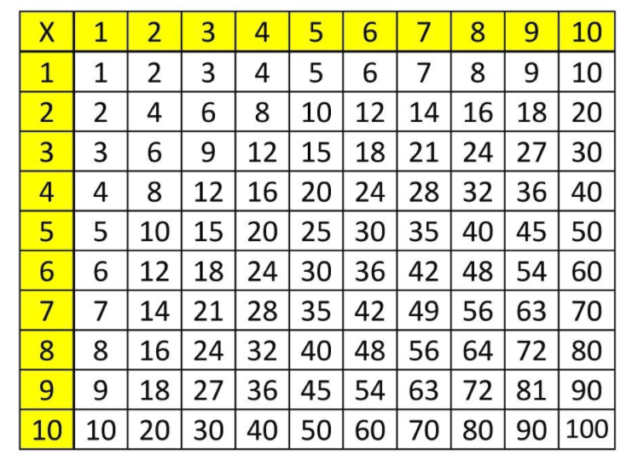
Hopefully your multiplication skills are sharp! Division has been described as the opposite of multiplication (they are inverse operations).
You can also use the multiplication table to help find your answer: 32 8 =
1) Using the '8' find it on the multiplication table
2) Follow the '8' to the '32'
3) Follow the 32 all the way across to the edge to find the answer.
Example: 32 8 = ?
Is the same as 8 x__= 32
8 x 4 = 32
SO
32 8 = 4
ALSO
32 4 = 8

Slide 3
Practice:
1) 25 5 = ?
5 x ___= 25
So 25 5 =_____
2) 63 7 =?
7 X ___ = 63
So 63 7
3) 16 2 = ?
2 x ___=16
So 16 2 =____
4) 125 0 = ?
0 X 125 =_______
So 125 0 =_____
5) 24 6 = ?
6 X ____ = 24
So 24 6 =_______
6) 48 8 = ?
8 X ___ = 48
So 48 8 = _____

Slide 4
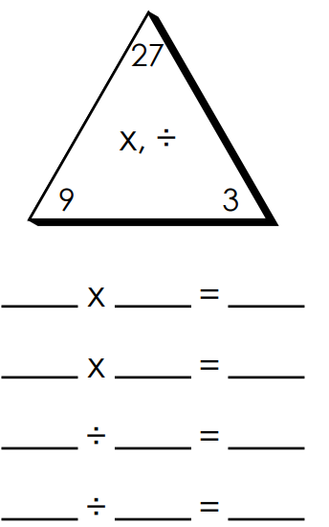
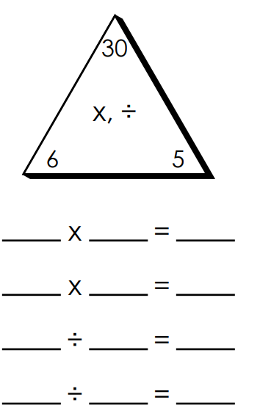
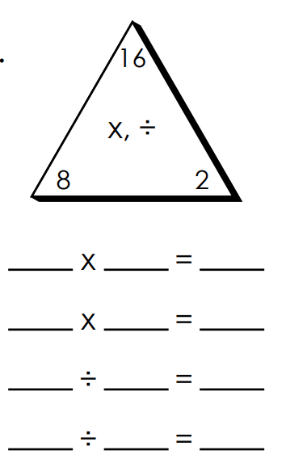
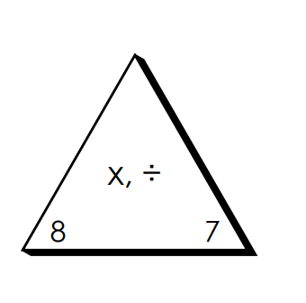
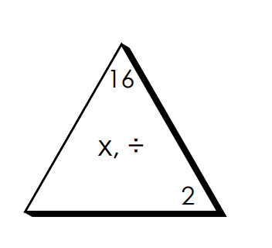
Try These Fact Family Activities, the first one is done for you.

Slide 5
Division With Remainders
Sometimes when we try to divide into equal groups, it doesn’t always work out that they are equal. In Division, the amount left over that can't be put in groups equally are called the REMAINDERS.
Example: Farmer Entz picks 15 apples for his two bins. How many apples are in each bin?
Solution: 15 2= 7 with 1 remaining. Written as 7r1
Solution Two: Use Multiplication!
Solution One: You can solve this in different ways!
Draw a picture! *Remember, each group must be equal, there cannot be a group that has more than the other!
15 2 =?
"What multiplies by 2 that gets you as close as you can get to 15 WITHOUT going over????
2x6=12 (I can get closer)
2x7=14 (very close, but I will try another)
2x8=16 (I am over!! 16 has gone over my starting question of 15)
Finally add to get your remainder:
2x7=14
14 + ___= 15 (obviously its 1)
So 15 2= 7 r 1 ******Your remainder can never be more than what you are dividing by!!!!! (So if you had remainder 3, that is more than the 2 groups you are dividing...it will be incorrect!)
Remainder
Apple Bin 1
Apple Bin 2
Total
How many in each Group
Groups

Slide 6
Practice: All of these questions will have a remainder!
You can either Draw A Picture (harder to do with bigger numbers and when the questions get more complex)
OR
Use Multiplication (A little more confusing because there are lots of steps)
1. Mr. Garner asks his students to arrange 30 chairs into 9 rows. How many chairs in each row?
2. Mr. Schalk has 26 Pokemon cards to give to 5 students. How many will each student get?
3. Ms. Tadey loves basketball. 50 kids have signed up for the 6 teams. How many kids are on each team?
4. Ms. Peters owes her students candy. She has 41 pieces of candy and only 7 students who have earned it. How many pieces of candy does each student get?
5. Mr. Entz won the lottery. He now was 73 laptops to give away to his favourite 8 students. How many laptops does each student get?
Answers in random order:
5r1
3r3
9r1
5r6
8r2

