Slide 1
Long Division
Lesson 3 of 3

Slide 2
Please Check Out These Videos from Mrs. Braun
Or Click HERE
This is a different way to look at it!
Click HERE

Slide 3
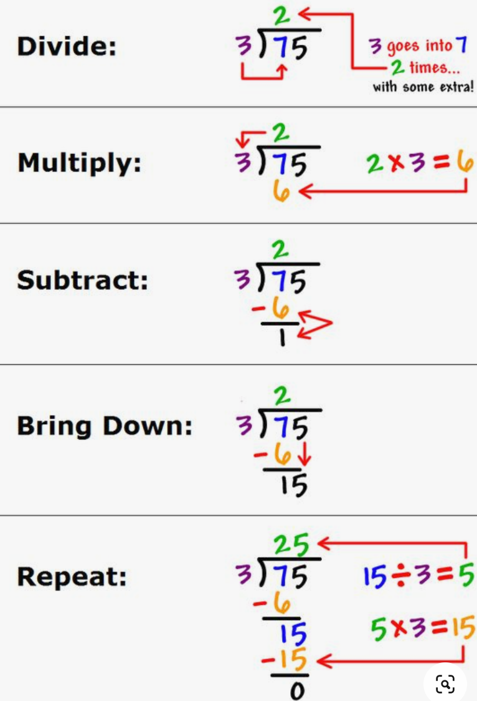
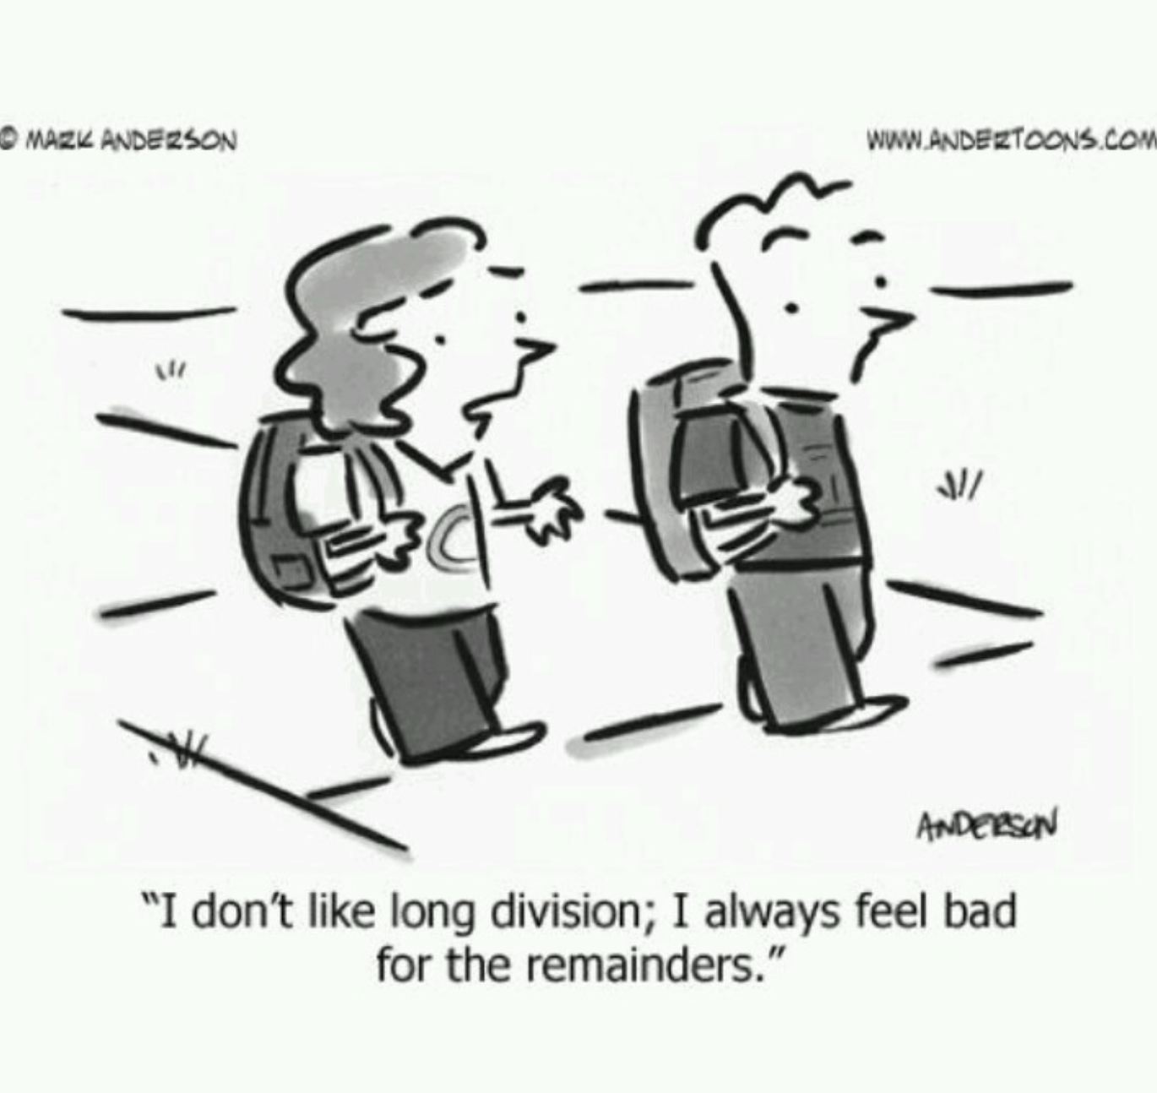
Long Division is often one of the most challenging math units for students to grasp! SO....don't worry if you don’t pick this concept up immediately!! :)
This is how your parents learned it, most likely.

Slide 4
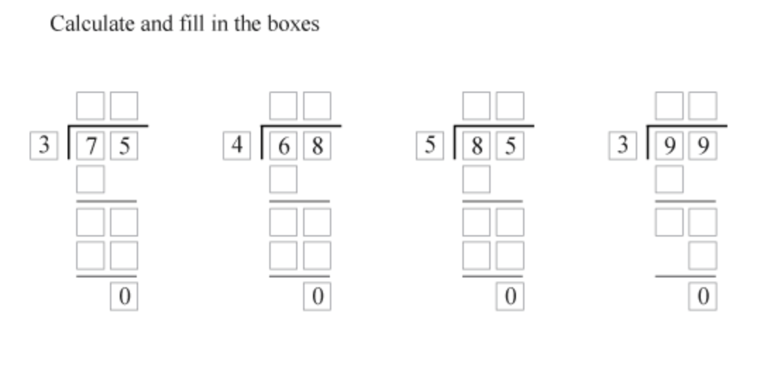
Practice: All of these questions will NOT have a remainder!
Answers in random order:
17
25
33
17

Slide 5
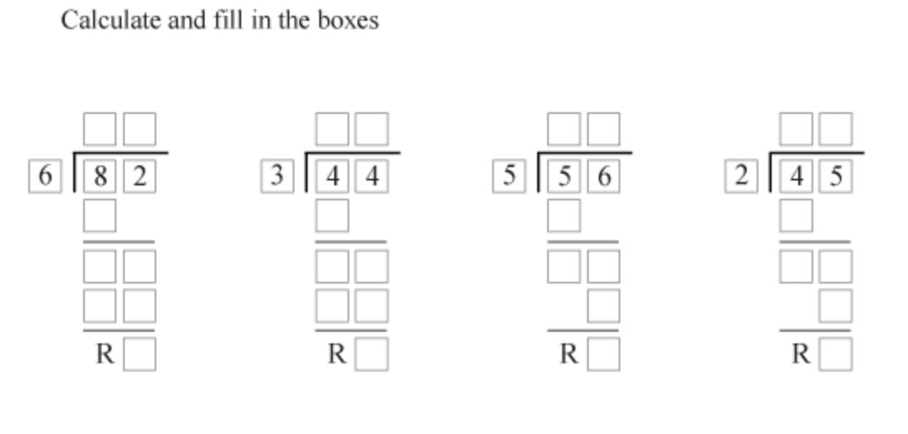
All of these questions WILL have a remainder!
Answers in Random Order:
22r1
11r1
13r4
14r2

Slide 6
When Complete; check out these division websites for games, they are on the 'easier' side of things (there are some advertisements on the side, don’t click them!)
https://www.multiplication.com/games/division-games
Or
https://www.mathplayground.com/grade_4_games.html
(for this one, read the titles to find division games, there are some multiplication mixed in)

