Slide 1
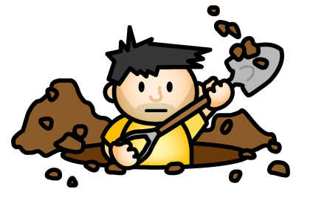
PART THREE- REFLECTIONS
DIG DEEPER INTO STORIES USING THE ‘3-R’ STRATEGY

Slide 2
Over the past two weeks, we have learned that there are different layers of understanding when we read stories. I explained in previous tasks how we can develop a stronger understanding of stories through:
Retelling
Personal Responses (Relating)
Reflecting

Slide 3
This week, we will dig the deepest hole to understand stories by seriously reflecting on what we have read. In order to reflect, we need to think hard to find hidden messages to develop new perspectives, to understand the author’s message, to identify themes, or to learn life lessons!
Last week, we read the story ‘Three Cheers for Wacky’ to help us learn how to make personal responses by relating or connecting with its characters, problems, events and physical features.
Please read this story again and I will show you how to
make deep reflections about what you have read.

Slide 4
(Please click on the arrow below if the link to the title on the previous page does not work for you.)

Slide 5
Before I give you examples of how to reflect on stories, there are some terms you need to understand:
Author’s Purpose:
Authors have three purposes for writing. They write to persuade, inform or to entertain.
Authors will persuade you to change your mind, have you do something, or make you believe something.
Authors will inform you by teaching you something or giving you facts.
Authors will entertain you by using their craft to make you enjoy what you are reading.

Slide 6
Themes:
Authors use themes to send readers an important message, or to teach valuable lessons. Themes have a real-world connection that teach life lessons or morals. Here are some common examples of themes:
Courage
Acceptance
Perseverance
Good vs Evil
Cooperation
Friendship and Love
Other Themes:
Action speaks louder than words.
Money doesn’t buy happiness.
Differences can bring people together.
Be true to yourself.
Appearances can be deceiving.

Slide 7
Perspectives
Perspective is a combination of a person’s background, experiences, knowledge , preferences, feelings and thoughts. Each person has their own unique perspective. Perspectives influence our points of view when certain issues or situations occur.
In short, perspective is the way you see and react to something. It is different for each person.
Two people or characters may have different perspectives.
A reader may have a different perspective than a book character.
A reader may have different perspectives than the author of a book.
Authors often use their craft to change the perspectives of their readers, by persuading or informing them, or by teaching them important lessons about life.

Slide 8
On the next slide, I will write a reflection to show my deep understanding of the story Three Cheers for Wacky by:
Stating the author’s purpose (persuading, informing or entertaining).
Identifying hidden messages or themes.
Explaining how the author used characters or problems to change my perspective.
Thinking about what life lessons the story has taught me.

Slide 9
I think the author had two purposes in mind. The first was to entertain me through humor, funny pictures and a wacky character! The second was to persuade me through Wacky’s actions and personality that appearances are deceiving and that it’s great when people dare to be different! The story was comical and fictional so I don’t think the author’s message was meant to teach me about penguins.
The author had several hidden messages. After reading the story, I felt the author identified important themes through the characters, problems and events of the story. It taught me that we all shine in different ways and that it is important to be yourself. It also taught me to persevere and to have courage. The penguins and audience learned that differences can bring people together.
I like how Tacky’s actions changed the perspective of others. In the end, his own team, as well as the judges and audience changed their perspectives, as well as appreciated his humor and unique talent. I know the author was trying to persuade me to empathize and cheer for Tacky. He used illustrations, language and actions to make me feel sorry for and learn from Tacky. I am a teacher and it reminds me of how important it is to acknowledge the talents and abilities of all students. It also teaches me to persevere. I sometimes get frustrated learning about the fast changing technology today. Tacky changed my perspective in that you have to take risks and believe in yourself to be successful.

Slide 10
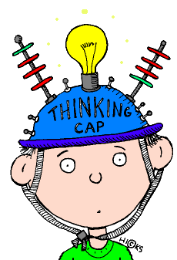
Now get a piece of lined paper! It’s your turn to read and write a reflection to show your deep understanding of the story The Giving Tree by Shel Silverstein.
(*Please use the link on the following slide if the title link does not work!)
Please make sure you:
State the author’s purpose (persuading, informing or entertaining).
Identify hidden messages or themes.
Explain how the author used characters, problems or events to change your perspective.
Think about what life lessons the story has taught you.

Slide 12
I hope you enjoyed learning how to
use the ‘3-R’ strategy to
develop a deeper understanding of stories!

