Slide 1
FRACTIONS
Lesson 2

Slide 2
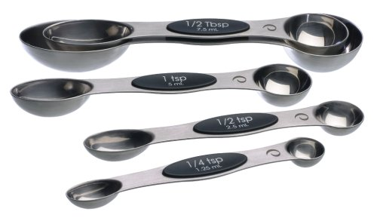
Where do we see fractions?
Fractions are used in everyday life... much more than you may think. If you have ever baked or helped someone bake something – you have used fractions!
This Photo by Unknown author is licensed under CC BY-SA-NC.

Slide 3
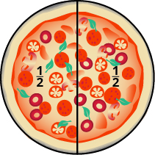
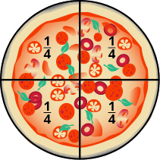
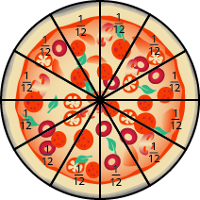
If you've ever eaten pizza...
You have seen fractions! Next time you eat a pizza, look at what fraction your pizza is cut into and then see what fraction you eat of the pizza!
This Photo by Unknown author is licensed under CC BY.
This Photo by Unknown author is licensed under CC BY.
This Photo by Unknown author is licensed under CC BY.

Slide 4
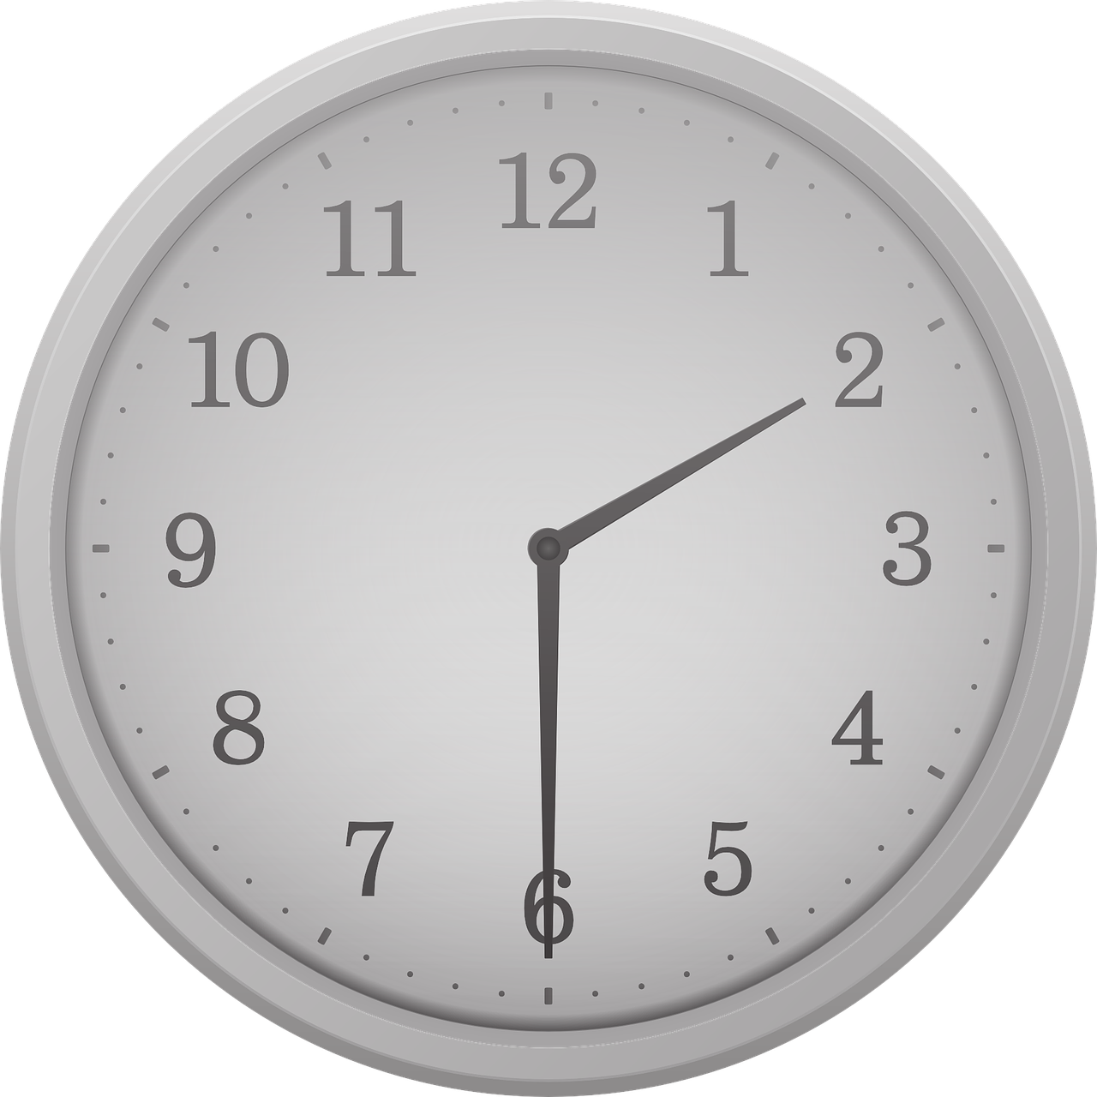
When you tell time!
You may have heard the phrase "it is half past six" before. This is telling you that it is 6:30.
You may have heard the phrase "it is quarter after four" meaning it is 4:15 or "it is quarter to one" meaning it is 12:45.
When you hear this, you are hearing fractions being used!
This Photo by Unknown author is licensed under CC BY-SA.

Slide 5
Your Turn!
Can you think of two more ways that fractions are used in our everyday life? Write them down!

