Slide 1
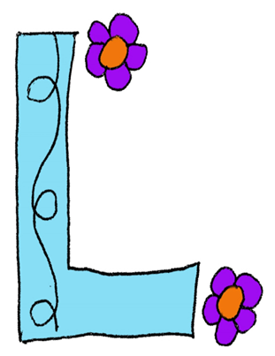
CHARACTERS ARE JUST LIKE PRESENTS-
THEY ARE FULL OF SURPRISES!
A LESSON ON …
CHARACTER TRAITS AND DEVELOPMENT:
WHAT CAN CHARACTERS TEACH US?
This Photo by Unknown Author is licensed under CC BY-NC

Slide 2
The best stories include engaging characters who draw you into their world and problems. Authors use different techniques to help you empathize with characters, as well as to question their actions or motives. Remember, even the best characters have flaws that lead to conflicts.
Please view the next two video clips to learn how authors use character traits and character development to enable readers to learn about and make strong connections with their characters. You will also find that characters change throughout a story. They often learn or teach us a valuable lesson.

Slide 3
https://www.youtube.com/watch?v=Bp01Egn90C8
(Last slide is not applicable to this lesson.)

Slide 4
https://www.youtube.com/watch?v=wWYpj9aqTr0

Slide 5
On the first slide, you read the following….
CHARACTERS ARE JUST LIKE PRESENTS-
THEY ARE FULL OF SURPRISES!
Please go to the next slide to view the following short film entitled The Present.
*Remember to pay close attention to the characters to learn about their attributes, as well as to observe how they relate to each other or change.

Slide 6
https://www.youtube.com/watch?v=WjqiU5FgsYc

Slide 7
Please click on the following pdf attachment to record your thoughts about the characters in The Present.
https://lethsd51-my.sharepoint.com/personal/arlene_wagar_lethsd_ab_ca/Documents/Desktop/character%20traits%20development%20pdf.pdf

