Slide 1
FRACTIONS Lesson 4

Slide 2
Equivalent Fractions Introduction
LINK TO VIDEO

Slide 3
Generating Equivalent Fractions
Link to Video

Slide 4
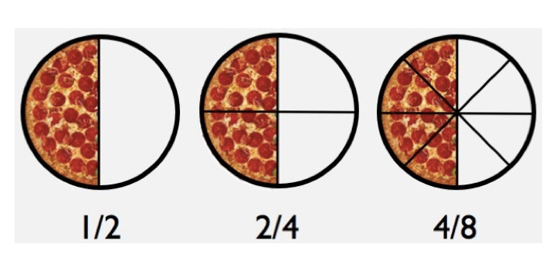
Although each of these fractions are different, they all represent the same amount of pizza eaten. These are what we called an equivalent fraction.

Slide 5
To find equivalent fractions, multiply the numerator and denominator by the SAME number.

Slide 6
When making an equivalent fraction, you multiply the numerator and denominator by the SAME number to get your new fraction – this can be any number as long it is the SAME on the top and bottom.
For this fraction I am going to multiply by 3.
1
—
8
For this fraction I am going to multiply by 7.
3
—
4

Slide 7
Task: Make equivalent fractions for the fractions below.
Task a:
Task b:
3
— =
4
1
— =
2
2
— =
3
3
— =
5
6
— =
9
1
— =
4
1
— =
5
4
— =
6
3
— =
6
1
— =
3
4
— =
5
2
— =
7

