Slide 1
Dig Deeper into Poetry: Mood
*This task will take two
weeks to complete.
Story book authors and poets often use imagery (words relating to the senses), setting and word choice to help their readers connect closely with text. Together, these three elements generate the mood of a story or poem.
Several of my students have expressed a keen interest in learning more about poetry as they love to experiment with words to grow their imaginations and ignite their emotions! So I thought it would be fun to dig deeper into poetry by teaching students how mood can generate a richer understanding and appreciation of poetry.
So if you think you might be interested in joining us to work through some cool poems to learn about the element of mood,this is the reading task for you!

Slide 2
Please click on the following link
https://www.youtube.com/watch?v=SQq7XZ_Im34
or
Go to the next slide to open a short and sweet video clip to learn more about Mood…

Slide 4
Here are a few more things you need to know about mood:
Mood is the feeling the reader gets from reading a story or poem.
You figure out the mood through the setting or atmosphere of the poem/story.
Moods can change throughout a poem. Look for signal words- then, but.
Mood is not the feeling or attitude of a character.
Don’t use simple feeling words (sad, happy, mad) to describe mood.
Use more sophisticated words to describe mood such as:
Light-hearted Playful Hopeful Threatening Suspenseful Adoring
Cold Terrifying Lonely Haunting Liberating Joyous Peaceful Welcoming Violent Tender Warm Inclusive Pessimistic Optimistic Sentimental Confining Ridiculous Wishful Fearful Somber Devoted Tense Apprehensive Humorous Sympathetic Confusing

Slide 5
Now I would like you to explore different poems to develop an understanding of mood by:
Reading each of the following poems over two or three times.
Considering your feelings as you read.
Jotting down words or phrases that help support your feelings of what you are reading.
Selecting a mood word based on evidence from the text.

Slide 6
Now here’s your chance to interpret the mood of Shel Silverstein’s famous poem entitled Sick on the next slide.
Go to the next slide and view a video version of this poem.
Read the poem two or three times.
Complete the response forms located on the last three slides.

Slide 7
Click on one of the following links:
https://www.youtube.com/watch?v=t7OzQSZkczA

Slide 8
Now interpret the mood of Jack Prelutsky’s famous poem entitled Smart on the next slide.
Go to the next slide and view a video version of this poem.
Read the poem two or three times.
Complete the response forms located on the last three slides.

Slide 9
https://www.youtube.com/watch?v=g8QpsV7BThc

Slide 10
Now interpret the mood of Judith Viorst’s famous poem entitled Since Hanna Move Away on the next slide.
Go to the next slide and view a video version of this poem.
Read the poem two or three times.
Complete the response forms located on the last three slides.

Slide 11
https://www.youtube.com/watch?v=0yRB12bHqZM

Slide 12
Now interpret the mood of Jack Prelutsky’s famous poem entitled Louder Than a Clap of Thunder on the next slide.
Go to the next slide and view a version of this poem.
Read the poem two or three times.
Complete the response forms located on the last three slides.

Slide 13
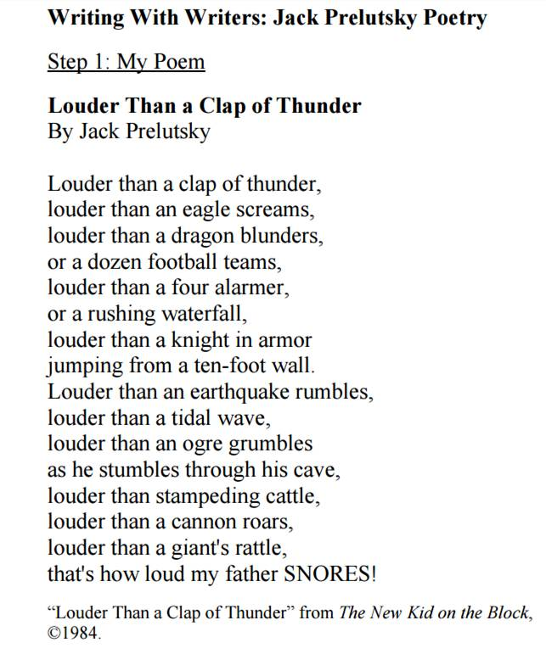

Slide 14
Now interpret the mood of SteveAttewell’s famous poem entitled The Fish That Couldn’t Climb Trees on the next slide.
Go to the next slide and view a video version of this poem.
Read the poem two or three times.
Complete the response forms located on the last three slides.

Slide 15
https://www.youtube.com/watch?v=csbban5TtQk

Slide 16
Interpreting ‘Mood’ in Poetry (Responses):
Use the vocabulary on slide 4 or brainstorm one or two of your own mood words to interpret the mood(s) in each poem. You may have to look up the meanings of some words.
2) Find words or phrases throughout each poem as evidence to justify your choice of mood words.
Sick by Shel Silverstein
Mood(s): Evidence from Text:
Smart by Jack Prelutsky
Mood(s): Evidence from Text:

Slide 17
Since Hannah Moved Away by Judith Viorst
Mood(s): Evidence from Text:
Louder Than a Clap of Thunder by Jack Prelutsky
Mood(s): Evidence from Text:

Slide 18
The Fish That Couldn’t Climb Trees by Steve Attewell
Mood(s): Evidence From Text:

