Slide 1
2-D & 3-D Geometry
Lesson 1

Slide 2
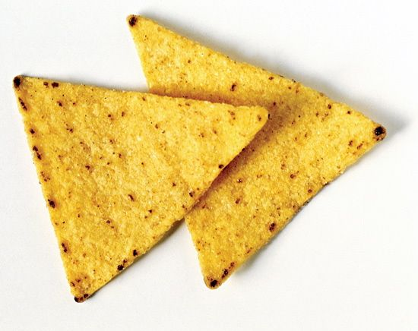
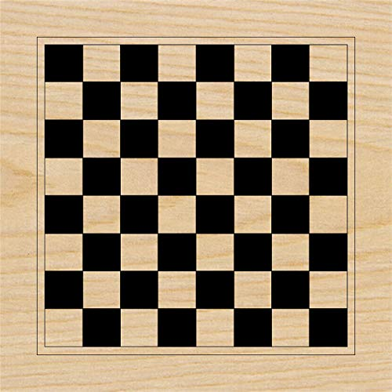
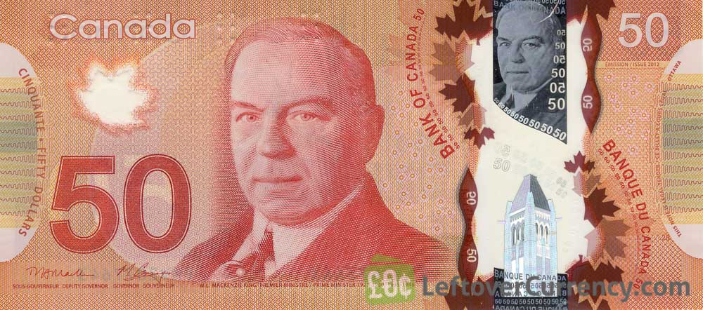
2-D Shapes review
Match the following 2-D shapes with their name:
1) Square
2) Triangle
3) Circle
4) Rectangle

Slide 3
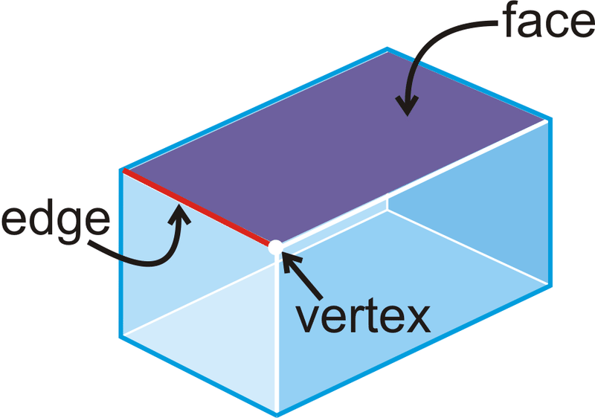
Quick overview of 3-D Shapes
Face = a 2D shape that makes up one surface of a 3D shape
Edge = a line where two or more faces meet
Vertex (corner) = the point or corner where two or more Edges meet

Slide 4
Watch this video for more in depth explanation of 3-D shapes
https://www.youtube.com/watch?v=3-QwWFkz5hw

Slide 5
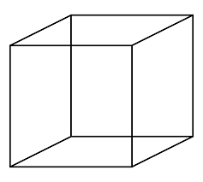
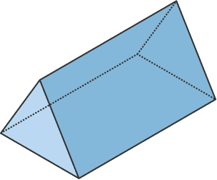
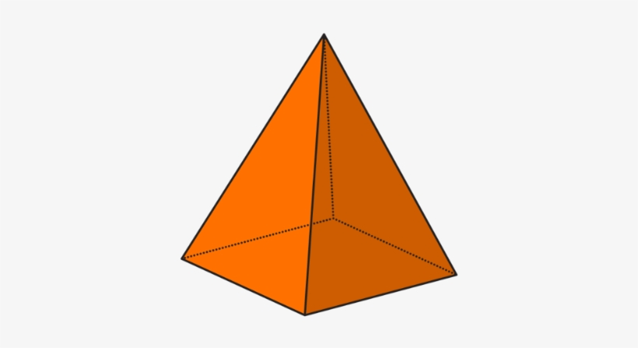
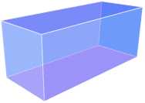
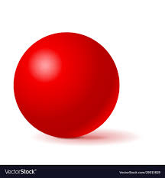
Let’s practice!
How many faces, edges and vertices does each shape have?
1) cube 2) triangular prism 3) square pyramid
4) rectangular prism 5) Sphere

Slide 6
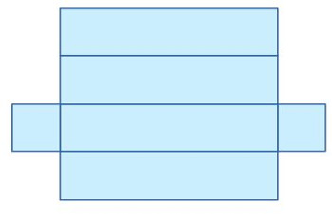
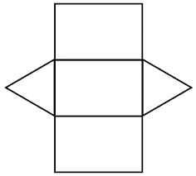
3-D Nets
Rectangular prism
Net = The net of a 3D shape is what it looks like if it is opened out flat. A net can be folded up to make a 3D shape.
Triangular prism

Slide 7
Watch this video to learn more about Nets
https://www.youtube.com/watch?v=x1xxTJ1tD_E&feature=youtu.be

Slide 8
Now it’s your turn to play around with nets!
1) Your task is to design at least one 3-D net of a triangular prism AND at least one 3-D net of a rectangular prism. You can use the ones on the previous slide but you need to draw it out, cut it out and fold it to make a 3-D shape. Better yet, make your own nets and cut them out and see how well you can do to make your own prisms! Send a picture of them to your teacher when finished.
2) When you’ve finished making your nets, make a list of at least 3 rectangular prisms and 3 triangular prism you can find in the real world.
Good Luck!

