Slide 1
NON-FICTION TEXT FEATURES
CAN YOU FIND THEM?
This Photo by Unknown Author is licensed under CC BY-NC-ND

Slide 2
Non-fiction text features are visual clues located in information text. They help you make better sense of new information and vocabulary that you read.
Please view the video clip on the following slide. It introduces the different text features found in non-fiction text.

Slide 3
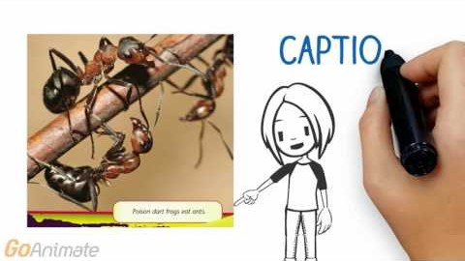
https://www.youtube.com/watch?v=3mAl9QMJJTo

Slide 4
Here is a list of the text features mentioned in the previous video clip:
Title
Captions
Table
Subtitle
Diagrams
Chart
Table of Contents
Labels
Graph
Glossary
Bold print
Map
Index
Italics
Timeline

Slide 5
Now it’s your turn to see if you can identify text features in non-fiction text.
Please select a non-fiction text from your home library or from an online website like EPIC BOOKS. Print this slide.
HIGHLIGHT THE TEXT FEATURES THAT YOU FIND AS YOU READ YOUR SELECTED BOOK.
TITLE OF BOOK: _______________________________________________________
Title
Captions
Table
Subtitle
Diagrams
Chart
Table of Contents
Labels
Graph
Glossary
Bold print
Map
Index
Italics
Timeline
*THIS ACTIVITY IS REPEATED ON THE NEXT TWO SLIDES IF YOU WOULD LIKE MORE PRACTICE TO LOCATE TEXT FEATURES IN ADDITIONAL NON-FICTION/INFORMATION TEXTS.

Slide 6
Now it’s your turn to see if you can identify text features in non-fiction text.
Please select a non-fiction text from your home library or from an online website like EPIC BOOKS. Print this slide.
HIGHLIGHT THE TEXT FEATURES THAT YOU FIND AS YOU READ YOUR SELECTED BOOK.
TITLE OF BOOK: _______________________________________________________
Title
Captions
Table
Subtitle
Diagrams
Chart
Table of Contents
Labels
Graph
Glossary
Bold print
Map
Index
Italics
Timeline

Slide 7
Now it’s your turn to see if you can identify text features in non-fiction text.
Please select a non-fiction text from your home library or from an online website like EPIC BOOKS. Print this slide.
HIGHLIGHT THE TEXT FEATURES THAT YOU FIND AS YOU READ YOUR SELECTED BOOK.
TITLE OF BOOK: _______________________________________________________
Title
Captions
Table
Subtitle
Diagrams
Chart
Table of Contents
Labels
Graph
Glossary
Bold print
Map
Index
Italics
Timeline

