Slide 1
History of Alberta
Frank Slide

Slide 2
What to do…
1. Read the words on Slide 3 to familiarize yourself with some of the trickier words.
2. Read the story and the information items aloud to someone who is looking after you. Practice fluency by paying close attention to punctuation, and read with lots of expression!
3. Watch the You Tube video of how Geologists are presently monitoring the Frank Slide.
4. Complete the worksheet and send it back to your teacher.
5. Choose your own adventure! (More details on Slide 11!)

Slide 3
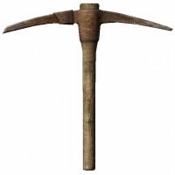
What does that mean? (Some of the trickier words and their meanings)
Timbers – wooden supports used to prevent the mine from collapsing
Airshafts – a passage to move fresh air underground
Pickaxes – T-shaped tool miners used for prying the coal off the sides of the mine
Summit – the highest point
Fissures – cracks in mountains
Geologists People who study events that have changed and shaped the Earth over time.

Slide 4
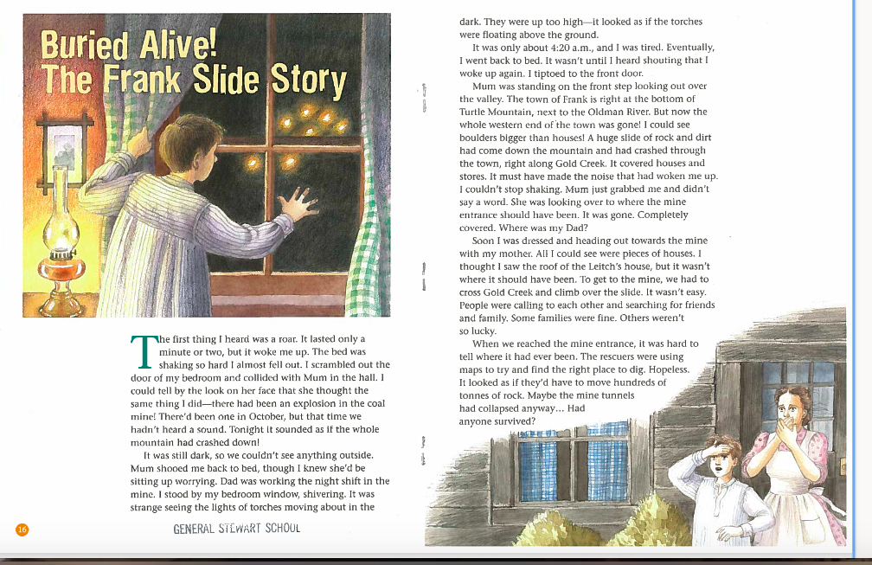

Slide 5
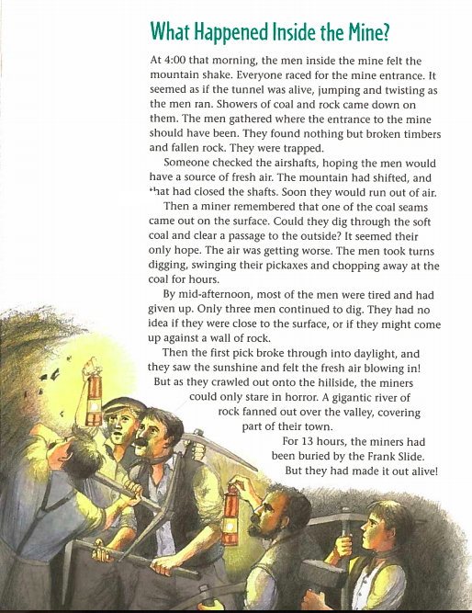

Slide 6
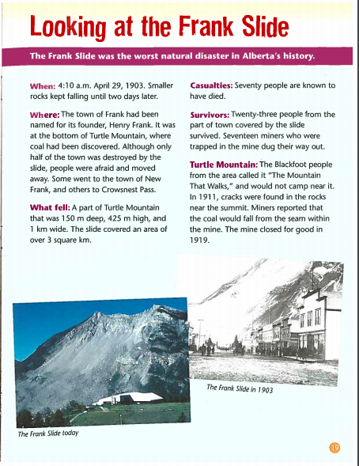

Slide 7
What caused the Frank Slide?
In 1903 the Crowsnest Pass had an unusually warm winter, with warm days and cold nights. Water in the mountain's fissures froze and thawed repeatedly which made the mountain weaker. Heavy snowfall in March, followed by a warm April caused the snow to melt into the fissures.
That night the temperature fell below -18 degrees Celsius. What does water do when it freezes? It expands. Geologists speculated that the cold snap resulted in rapid freezing of the fissures, causing them to expand. This caused the limestone to break off and tumble down the mountain. It is estimated that it only took 100 seconds to fall!

Slide 8
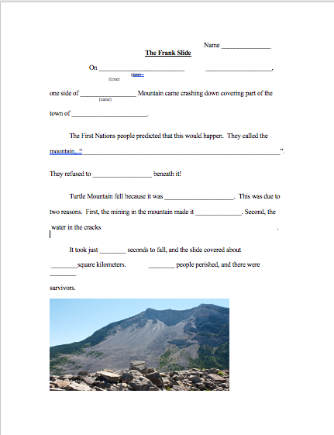
Please complete and send to your teacher

Slide 9
Watch this video to learn what Geologists are presently doing to monitor Turtle Mountain!
https://www.youtube.com/watch?v=Ml_xQuNWtEc

Slide 10
Choose Your Own Adventure! (…to show what you have learned!)
1. It is 1903 and you are a newspaper journalist for the Lethbridge Herald. Your Editor has sent you to the town of Frank to report on the slide. Write an article for the newspaper. It should also have a title and opening paragraph that will grab the reader’s attention!
2. Create a Power Point of what you have learned. Include pictures. Organize your slides with titles.
3. Write a poem about the Frank Slide. It can rhyme, but it doesn’t have to.
4. Write a play about the Frank Slide.
5. Create a comic book about the Frank Slide.
(Your adventure should include lots of facts. Think of answering the “5 W’s”: Who, What, Where, When, and Why!)

Slide 11
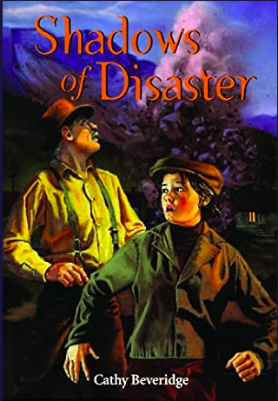
What is Historical Fiction?
Historical Fiction is a literary genre in which the plot takes place in a setting in the past.
You may be interested in reading one of these historical fiction novels about the Frank Slide disaster…
Shadows of Disaster (2003), Cathy Beveridge -- Jolene and her grandfather step through a time crease and she finds herself in the coalmining town of Frank a century earlier. Can she pass as a boy in 1903? Can she and her grandfather safely return to the present?
Terror at Turtle Mountain (2006), Penny Draper -- Thirteen-year-old Nathalie Vaughn lives in Frank in April 1903. Her cousin Helen is expected on the train the next day. When disaster strikes, Nattie has to find the strength and courage to help save her friends' lives.

