Slide 1
Geometry Lesson 2: Congruency & Symmetry

Slide 2
1.
CONGRUENCY

Slide 3
What does CONGRUENT mean?
CONGRUENT
Two objects that have the same SIZE and SHAPE
When placed over top of each other (SUPERIMPOSED – big Math word of the day ☺), the shapes match perfectly.
They are IDENTICAL.
EXAMPLES OF CONGRUENT SHAPES:
CLICK HERE to learn more about CONGRUENCY or click the video to the right

Slide 4
YOUR TURN!
1) Look at the shapes to the right. Colour the pairs of congruent shapes with the same colour.
This graphic can be downloaded from the website for printing and colouring by CLICKING HERE.

Slide 5
YOUR TURN!
2) Now see if you can trick a sibling or parent. Make and cut out a whole bunch of different shapes (at least 4 congruent pairs and 4 not congruent pairs). Have your parent or sibling try to find the congruent ones, make sure you explain what congruent means to them first and mix up the shapes real well. Have fun!

Slide 6
2.
SYMMETRY

Slide 7
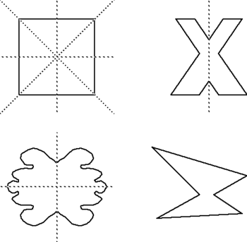
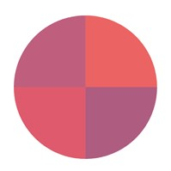
What is SYMMETRY?
When an object looks the exact same on one side as the other.
To see if an object is SYMMETRICAL, you draw a LINE OF SYMMETRY or a line dividing an object in half to show a perfect match on each side.

Slide 8
More on Symmetry
CLICK HERE to learn more about SYMMETRY
or
click the video to the right.

Slide 9
Let’s try it!
Identifying SYMMETRICAL shapes
Which of these shapes are SYMMETRICAL?.
1)
2)
3)
4)
5)
6)
7)

Slide 10
Let’s try it!
Your turn!
2) Create at least 5 SYMMETRICAL shapes. They can be any shape you want, as long as they are SYMMETRICAL.
3) Draw at least 1 LINE OF SYMMETRY on the shapes you created. Be careful to make sure it is a true LINE OF SYMMETRY. – how would you check to make sure?

